Slide 1



CRFM ML Workshop #5 Image Classification with Deep Neural Networks
Athos Nathanail
11/6/2024

Slide 2
Today’s Workshop
Image Classification
Concepts: Computer Vision, Supervised Classification, Transfer Learning
ResNet models
VGG models
Framework: Pytorch
New Libraries: Plotly, Pillow, Torchvision
Hands-on exercise (group work)
https://github.com/AthanasiosNathanail/Fossil-Image-Classification-with-Pytorch/tree/main
https://zenodo.org/records/7510741#.Y7voc3ZBwuV

Slide 3
November’s Workshops (Tentative)
Workshop #5 (11/6/2024): Image Classification with Deep Neural Networks
Workshop #6 (11/13/2024): ??
Workshop #7 (11/20/2024): Automated Velocity Picking with ML

Slide 4
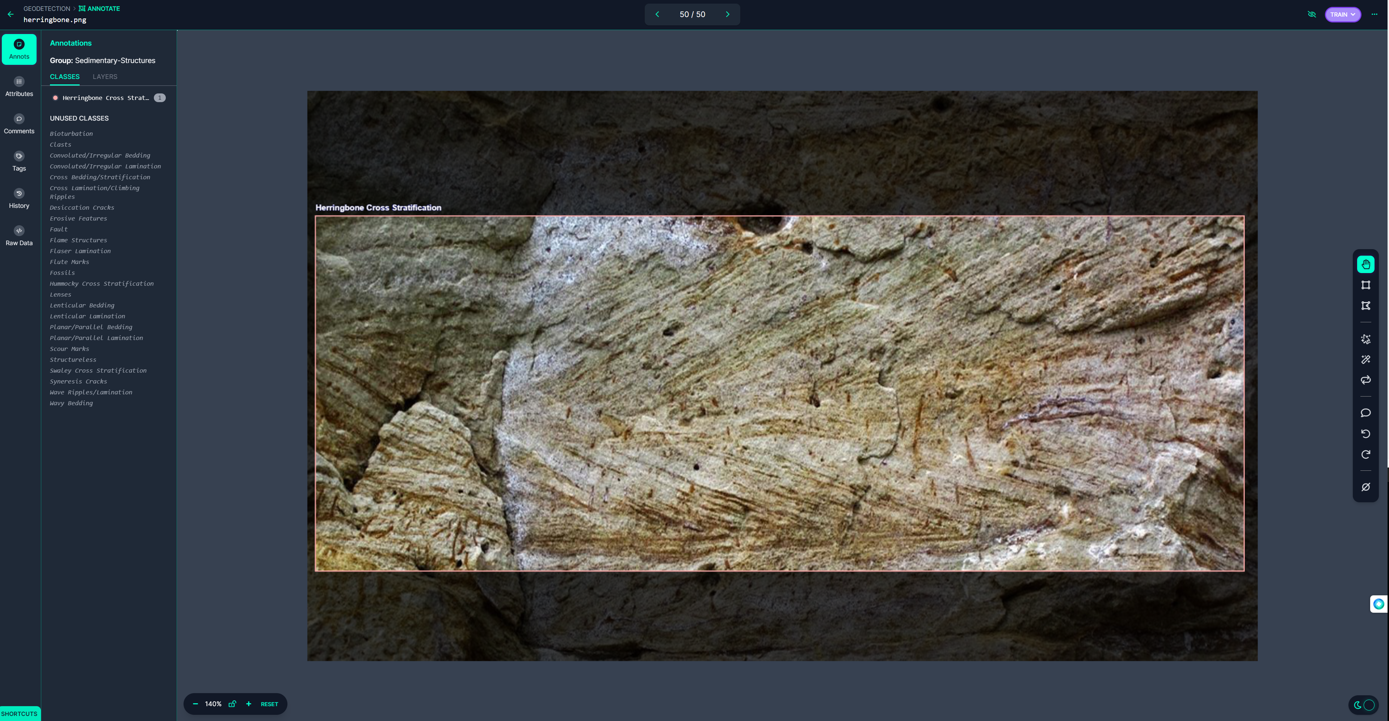
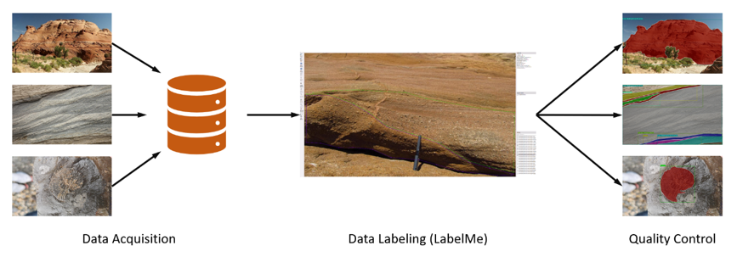
Concepts for Today
Computer Vision
Supervised classification
Transfer learning

Slide 5
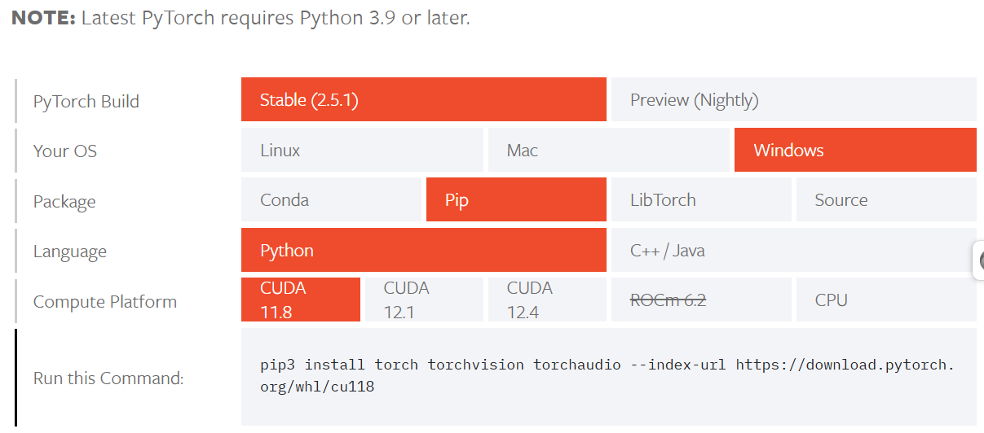
Pytorch framework
PyTorch is an open-source machine learning framework developed by Facebook's AI Research lab (FAIR). It provides tools for building and training neural networks with a focus on flexibility, dynamic computation graphs, and ease of use.
https://pytorch.org/get-started/locally/

Slide 6
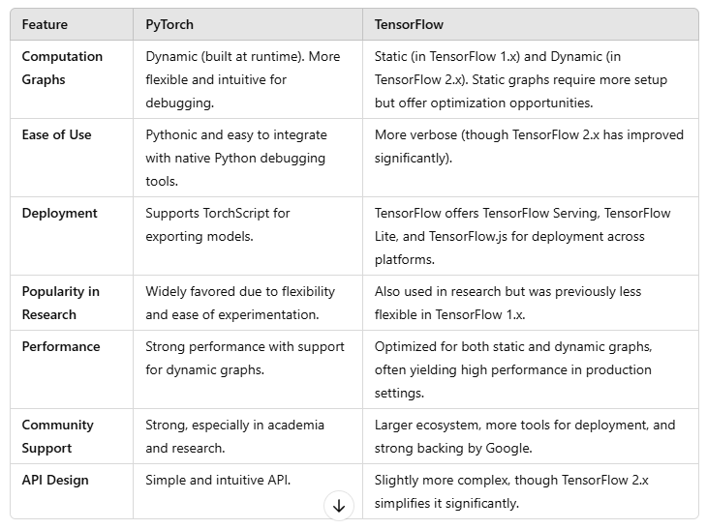
Pytorch vs tensorflow

Slide 7

New libraries: plotly
Plotly is an interactive data visualization library for Python, R, MATLAB, and JavaScript. It is well-known for creating dynamic, interactive, and highly customizable plots for web-based dashboards or standalone visualizations.
Key Features
Interactive Visualizations: Users can zoom, pan, hover for tooltips, and export plots.
Wide Range of Chart Types: Basic, Statistical, Financial, Geographical charts, and Customizable Dashboards
Ease of Integration
Built-in Animations
Support for Big Data
https://plotly.com/python/

Slide 8
New libraries: pillow
Pillow is a Python Imaging Library (PIL) fork that provides easy-to-use methods for opening, manipulating, and saving various image file formats. It's a powerful library widely used in image processing tasks, making it an essential tool for tasks like:
Image transformation and enhancement
Image filtering
File format conversion
Creating image thumbnails
https://python-pillow.org/

Slide 9

New libraries: torchvision
Torchvision is a Python library that provides tools specifically designed to work with image and video data as part of the broader PyTorch ecosystem.
Useful tools:
torchvision.datasets offers preloaded and easily accessible datasets (MNIST (handwritten digits), CIFAR-10, CIFAR-100 (object classification))
torchvision.transforms provides common image transformations to prepare data for training. (Data Augmentation, Normalization, Resizing and Cropping)
torchvision.models provides pre-trained deep learning models for image classification, object detection, and segmentation (ResNet, AlexNet, VGG, DenseNet, MobileNet)
https://pytorch.org/vision/stable/index.html

Slide 10
Resnet and vgg models
Both ResNet and VGG are popular Convolutional Neural Networks (CNNs) for image classification, but they differ significantly in terms of architecture, performance, and use cases.
Specific examples:
ResNet-50
VGG-16
Differences:
Architecture Design
Number of Parameters
Training and Performance
Accuracy and Generalization
Use Cases

Slide 11
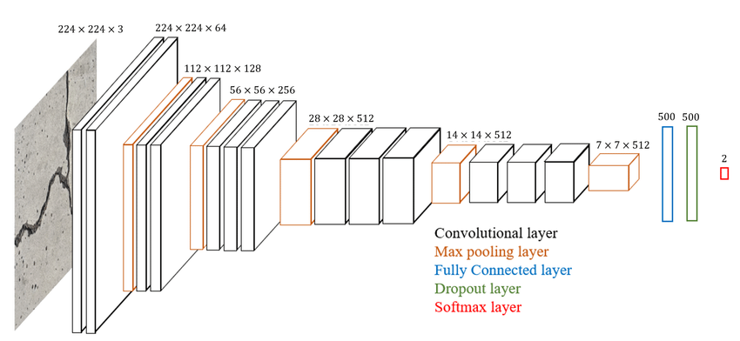
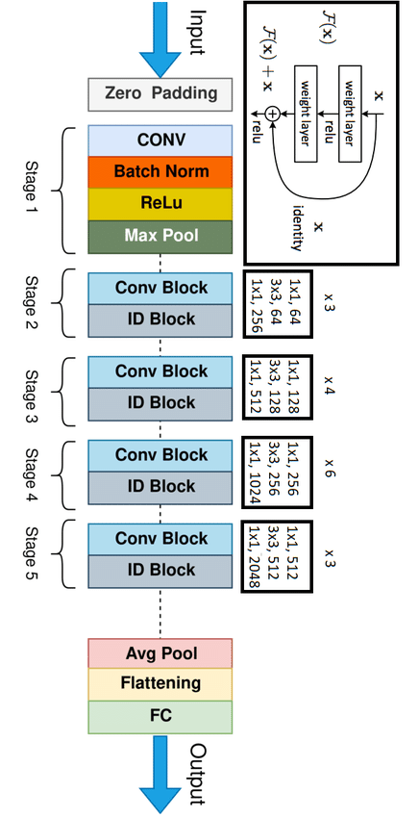
Resnet and vgg models
ResNet 50
VGG 16
https://images.app.goo.gl/DevKRLePNUSQm9km8
https://images.app.goo.gl/MoE4dtpFj5NSaweu7
Notes:
Architecture Design
VGG-16:
VGG-16 is a deep network with 16 weight layers (13 convolutional layers + 3 fully connected layers).
The architecture consists of:
Stacks of convolutional layers with small filters (3x3).
Max-pooling layers after each convolutional block.
Ends with 3 fully connected layers followed by a softmax output layer.
Key Characteristics:
Simple and uniform architecture.
Larger number of parameters due to fully connected layers.
Computationally intensive and prone to vanishing gradients as depth increases.
ResNet-50:
ResNet-50 is a much deeper network with 50 weight layers.
The core innovation of ResNet is the introduction of Residual Blocks, which include skip connections or identity mappings that:
Allow gradients to flow more easily during backpropagation.
Help in mitigating the vanishing gradient problem.
Key Characteristics:
Deeper architecture with bottleneck blocks.
More efficient gradient flow due to residual connections.
Fewer parameters than VGG-16 for the same depth due to the bottleneck design.
2. Number of Parameters
VGG-16:
~138 million parameters.
Larger memory footprint and slower to train.
ResNet-50:
~25.6 million parameters.
More efficient in terms of memory and computational cost.
3. Training and Performance
VGG-16:
Advantages:
Simpler to understand and implement.
Effective for smaller datasets and fine-tuning tasks.
Limitations:
Deeper layers suffer from vanishing gradients, making training difficult as the network deepens.
Slower and more computationally expensive due to large fully connected layers.
ResNet-50:
Advantages:
Can train deeper networks without vanishing gradient issues due to residual connections.
Achieves better accuracy on deeper models.
Faster training due to efficient parameterization.
Limitations:
Slightly more complex to implement and understand compared to VGG.
Requires more GPU memory during training due to additional operations in residual connections.
4. Accuracy and Generalization
ResNet-50:
Generally achieves higher accuracy on large-scale datasets like ImageNet.
Better generalization to new data due to the ability to train deeper networks.
VGG-16:
Performs well but tends to overfit on small datasets unless proper regularization is applied.
Lower accuracy compared to ResNet-50 on large and complex datasets.
5. Use Cases
VGG-16:
Feature extraction for transfer learning.
Simpler applications where model interpretability is essential.
ResNet-50:
Image classification on large-scale datasets (e.g., ImageNet).
Object detection and segmentation tasks as part of advanced pipelines.
Preferred in real-world applications where deeper networks are beneficial.

Slide 12
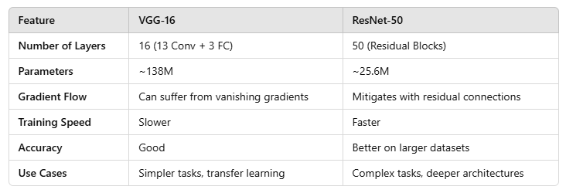
Resnet and vgg models (Summary)
VGG-16: Simpler but heavier. Good for transfer learning and smaller datasets.
ResNet-50: Deeper, more efficient, and more accurate. Ideal for modern, large-scale tasks.
Notes:
What is the Vanishing Gradient Problem?
The vanishing gradient problem is a common issue in deep neural networks, particularly when training models with many layers. It occurs when the gradients of the loss function become very small as they are backpropagated through the network. This leads to very slow or stalled learning in the earlier layers of the network.
What is a Gradient in Machine Learning?
In the context of machine learning and deep learning, a gradient refers to the partial derivative of a function with respect to its input variables. It measures the rate of change of a function (such as a loss function) with respect to the model's parameters (weights and biases).
What Are Residual Connections?
A residual connection is a shortcut that skips one or more layers in a neural network. It allows the input of a layer to be added directly to the output of a deeper layer, bypassing intermediate computations.

Slide 13
Dataset – synthetic fossil images
Geo Fossils-I is a synthetic dataset of fossil images that was created to solve the limited availability of Image Classification and Object Detection on 2D images from geological outcrops.
Links to paper:
https://pmc.ncbi.nlm.nih.gov/articles/PMC10293944/ https://www.sciencedirect.com/science/article/pii/S2352340923003074?via%3Dihub
The dataset consists of six different fossil types found in geological outcrops, with 200 images per class, for a total of 1200 fossil images.
Link to dataset: https://zenodo.org/records/7510741#.Y7voc3ZBwuV

Slide 14
Script: Fossil Classification with PyTorch
Dataset Setup and Conditioning
Data Loading: Loads fossil image data from a specified directory.
Visualization: Displays sample images and generates a bar chart showing the distribution of images across different fossil categories.
Dataset Splitting: Splits data into training, validation, and test sets using train_test_split.

Slide 15
Script: Fossil Classification with PyTorch
Data Preparation
Data Augmentation: Applies transformations such as random cropping, rotation, and color jittering to augment the training data.
DataLoader Setup: Creates PyTorch DataLoader objects for each data split.

Slide 16
Script: Fossil Classification with PyTorch
Model Building
Pre-trained ResNet50: Utilizes a ResNet50 model pre-trained on ImageNet, modifying its final fully connected layer to fit the fossil classification task.
Freezing Layers: Freezes all layers except the newly added classifier to retain the pre-trained feature extraction.

Slide 17
Script: Fossil Classification with PyTorch
Training
Loss and Optimizer: Uses Negative Log Likelihood Loss (NLLLoss) and Adam optimizer.
Training Loop: Trains the model while saving the best-performing weights.
Metrics Visualization: Plots training and validation losses and accuracies over epochs.

Slide 18
Script: Fossil Classification with PyTorch
Evaluation
Inference: Tests the model on unseen test data and calculates top-k accuracy.
Confusion Matrix: Generates and visualizes a confusion matrix to analyze misclassifications.
Per-Class Accuracy: Evaluates accuracy for each fossil category.

Slide 19
Script: Fossil Classification with PyTorch
Prediction
Single Image Prediction: Predicts the class of a single test image and visualizes the results.
Class-Specific Evaluation: Displays predictions for randomly selected images from specific fossil categories.

Slide 20

Hands-on exercise

Slide 21
Group Exercise
Retrain the script with your parameters and manipulate data to get the highest possible accuracy.
Select images for train,val,test
Test images can be downloaded from Google if you want to test the model’s ability further
Select a different model architecture
ResNet 18
ResNet 34
ResNet 50
VGG 16
VGG 19

Slide 22
Useful links so far
https://pytorch.org/get-started/locally/
https://github.com/AthanasiosNathanail/Image-Classification-with-Pytorch-on-a-Custom-Dataset
https://github.com/AthanasiosNathanail/Fossil-Image-Classification-with-Pytorch
https://zenodo.org/records/7510741#.Y7voc3ZBwuV

Slide 23
Workshop #5 Survey
https://forms.office.com/Pages/ResponsePage.aspx?id=4AlymbMJI0aaTXavpEpnXEj2nWIBKVdEhTERwugcImJUM0FVNUVQRUFQWks3TDZWUDNWWjI4UEU0Sy4u fix
Thank you!

